Slide 1
A60-A70
Bonded at 375C, 40N 15 mins
Failed at 2N

Slide 2
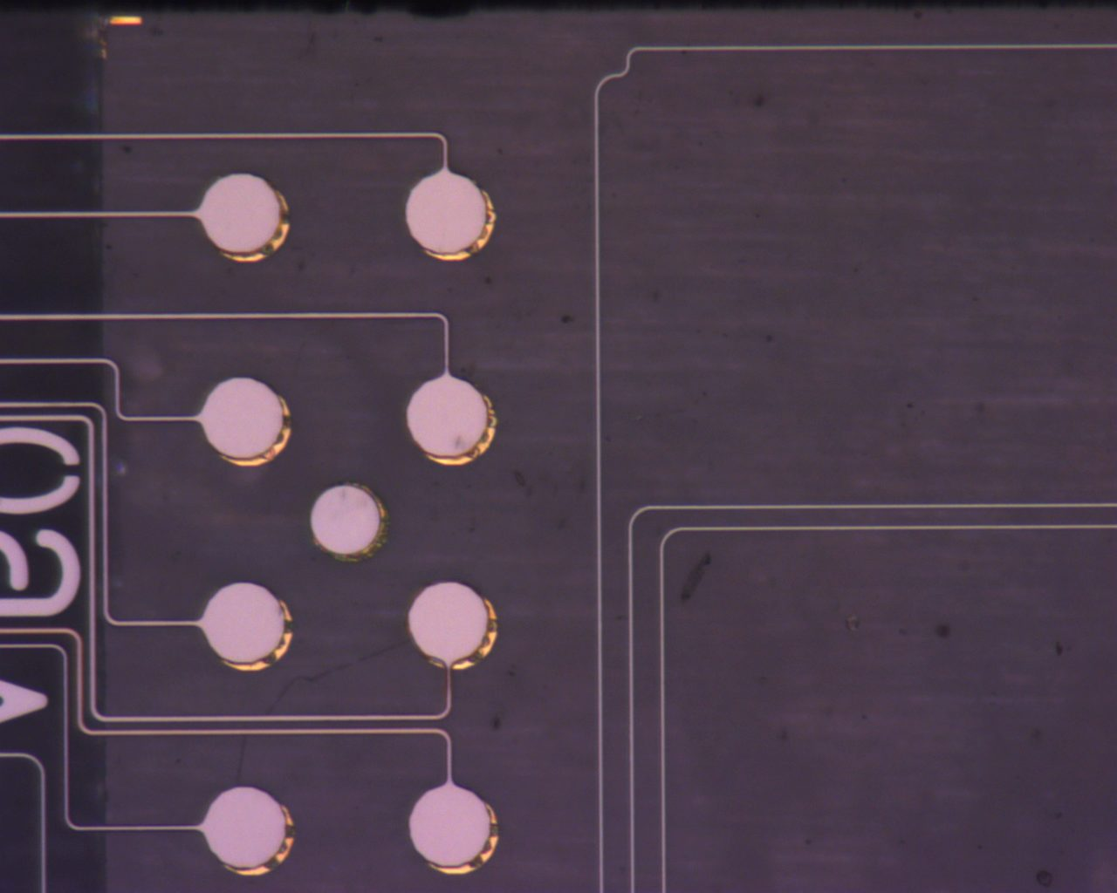
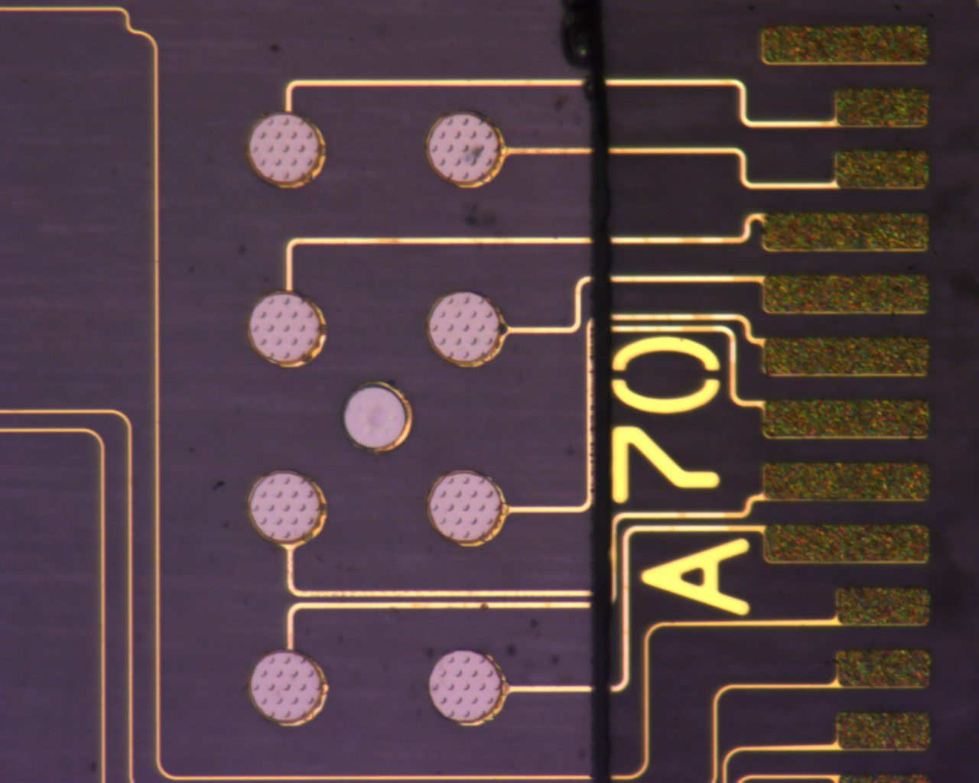
A60 (Back)
Pre pull test

Slide 3
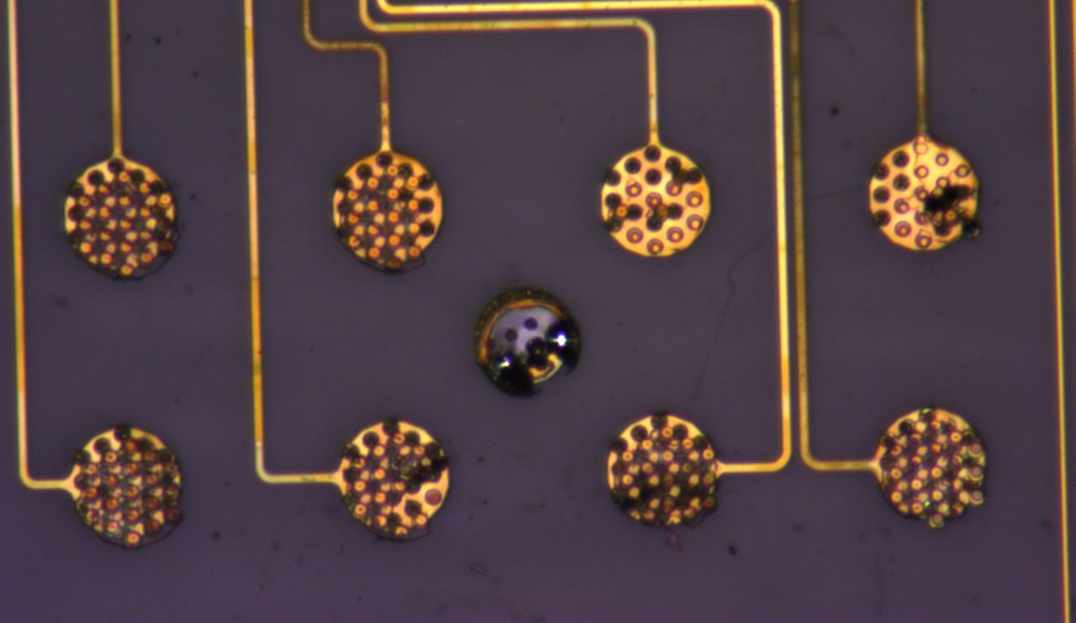
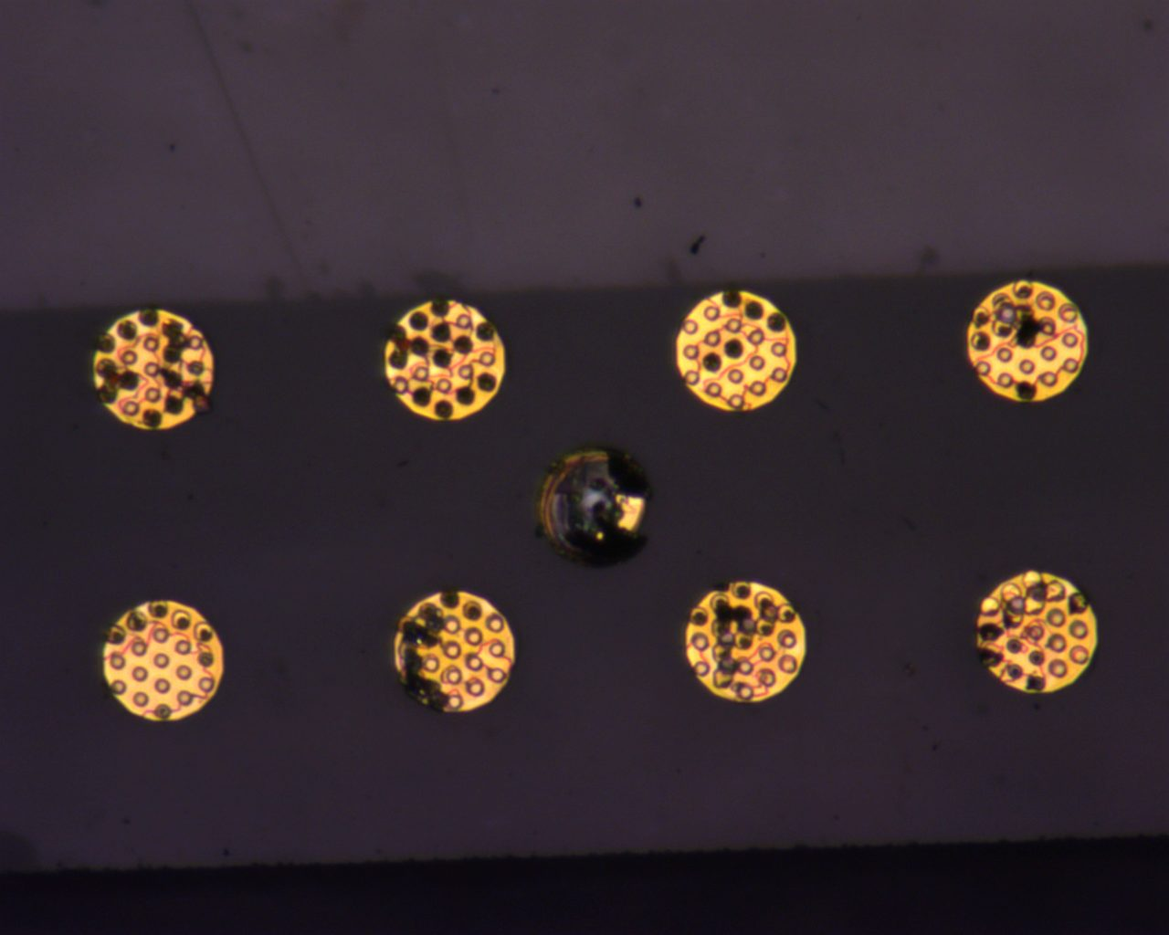
A60 (Front)
Post Pull Test

Slide 4
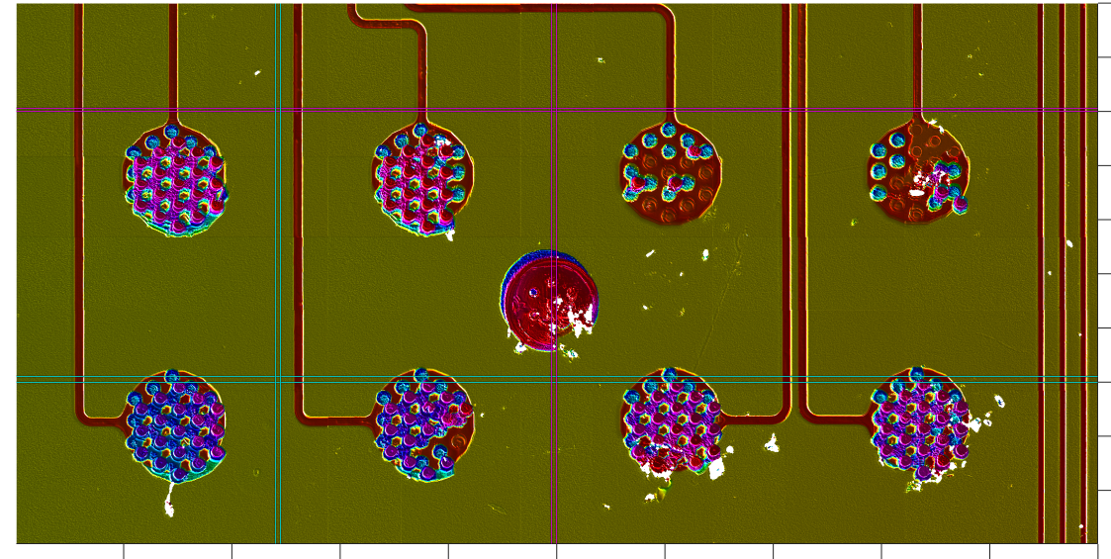
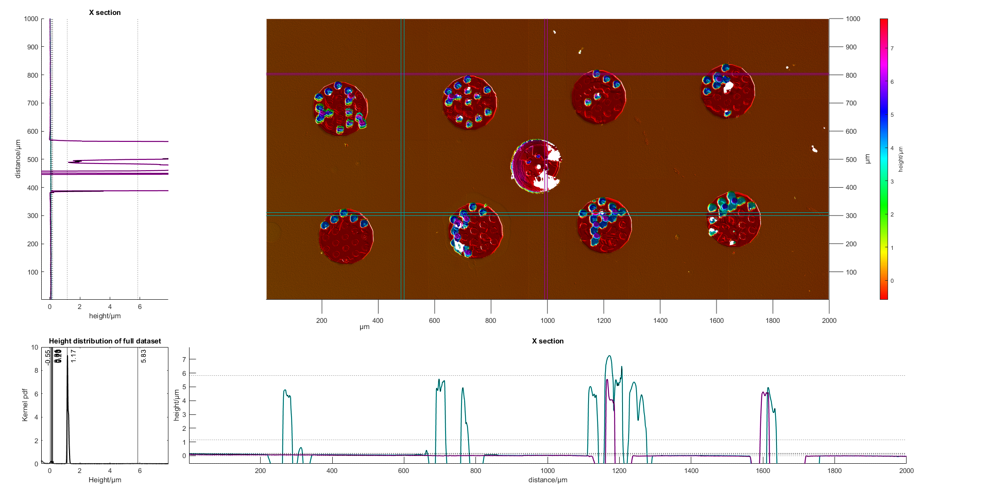
A60

Slide 5
A60 (Nearside)
Pads 1,2,5,6,7,8:
A ‘mesh’ of vias is seen attached above the pads, with a height of approx. 8um.
Pad 1,2,7,8 have a higher height than 5,6 ( 6.6um on pad 5)
No individual vias are seen.
Matches with other strip as loss of PEVCD, but based on images, is not adhesion metal.
Mesh is not complete- it seems to join the closest two vias rather than fully enclose the surface.
There is presence of a bump above the mesh- possibly failure from a new layer from the other strip?

Slide 6
A60 (Nearside)
Pad 1: Clear evidence of this mesh being transparent – bottom right hand corner is circular in shape, from other strip. This is the PECVD layer on top of the vias
Mesh joins alternating vias, not a full plane.
Check for deformation of the vias.

Slide 7
A60 (Nearside)
Pads 3,4:
Single free standing vias are seen, quite evenly spread out across the whole pad.
Height of 10 um at highest (pink), but others have heights of 5um.(blue)
Pink regions indicate that bonding has failed at adhesion layer of other pad, while blue region is failure of at gold-gold interface

Slide 8
A60 (Nearside)
Pad 9:
Transfer of gold pad from other strip
Presence of vias seen indicates that some failure occurred at glass-adhesion layer.
Colour of pad indicates that the adhesion layer is attached on this side.

Slide 9
A60 (Farside)
Pad 1-8 :
Freestanding vias seen again, rather than the mesh.
Vias have height of approx. 7um.
While remainder of pad has vias removed to the PECVD
Presence of PECVD is not as extensive as the nearside, but definitely is present between the vias.
Pad 7: Highest points are grey (Titanium), with glass behind it(portions with missing data)
Pad 7 exhibits all 3 modes of failure.

Slide 10
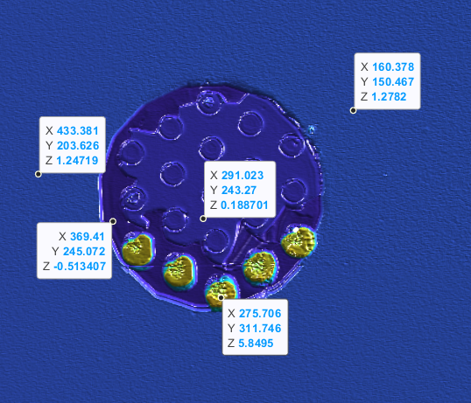
A60 (Farside)
Pad 8: Evidence of missing PECVD on the pads itself, with the area AROUND vias being lower than the area without the vias (??)
Pad 1

Slide 11
A60 (Farside)
Pad 9 :
Again, adhesion layer has from other strip is attached on this side. (Pad height 9um)
Partial pad peeling on LHS seen, with some transfer of the vias (3um tall).

Slide 12
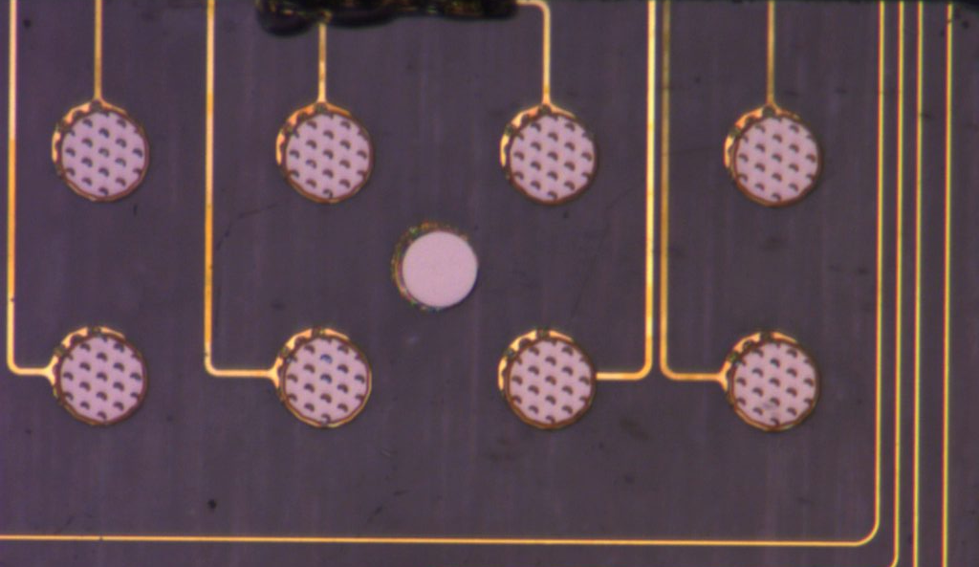
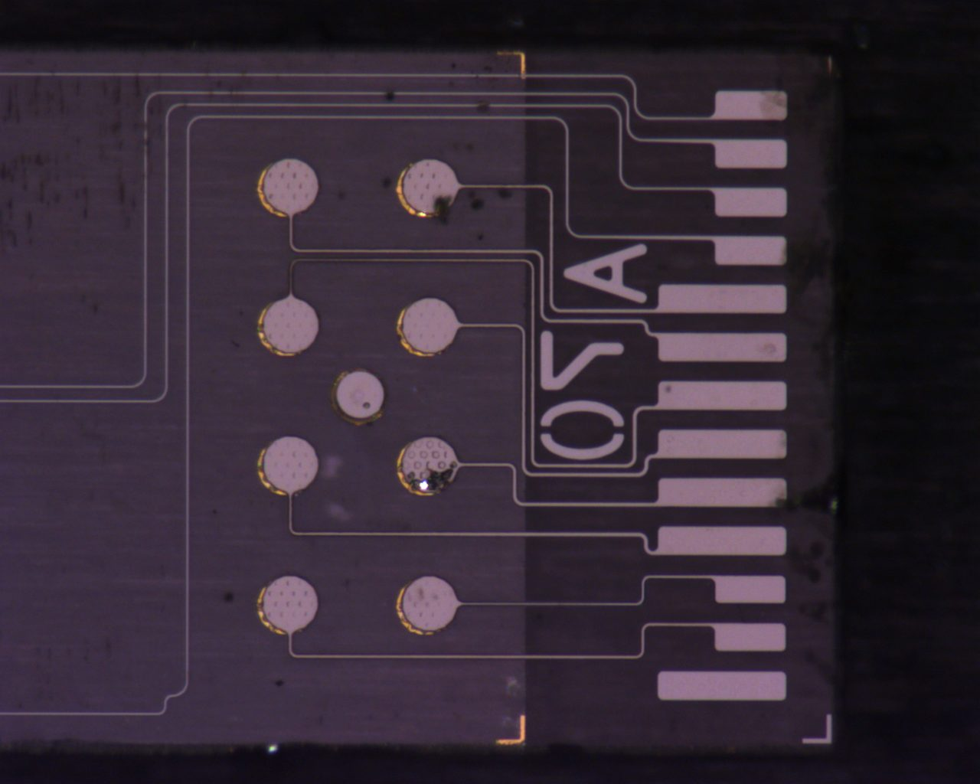
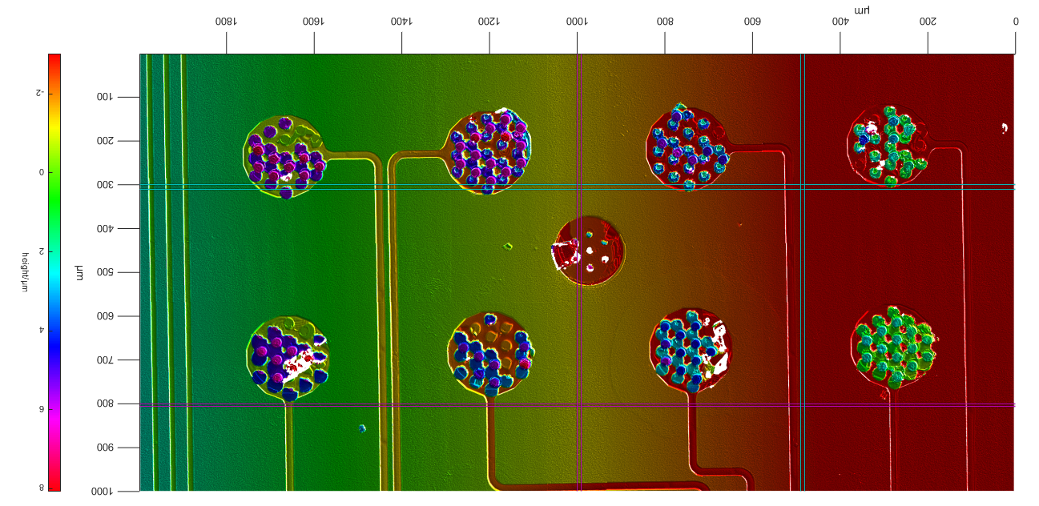
A70 (Back)
Pre Pull Test

Slide 13
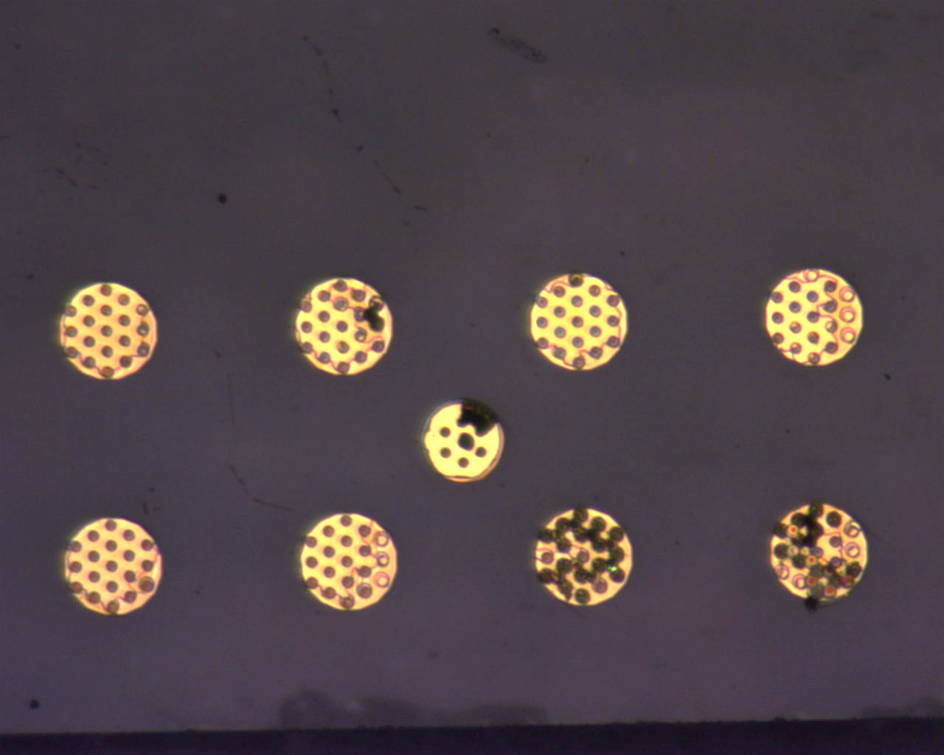
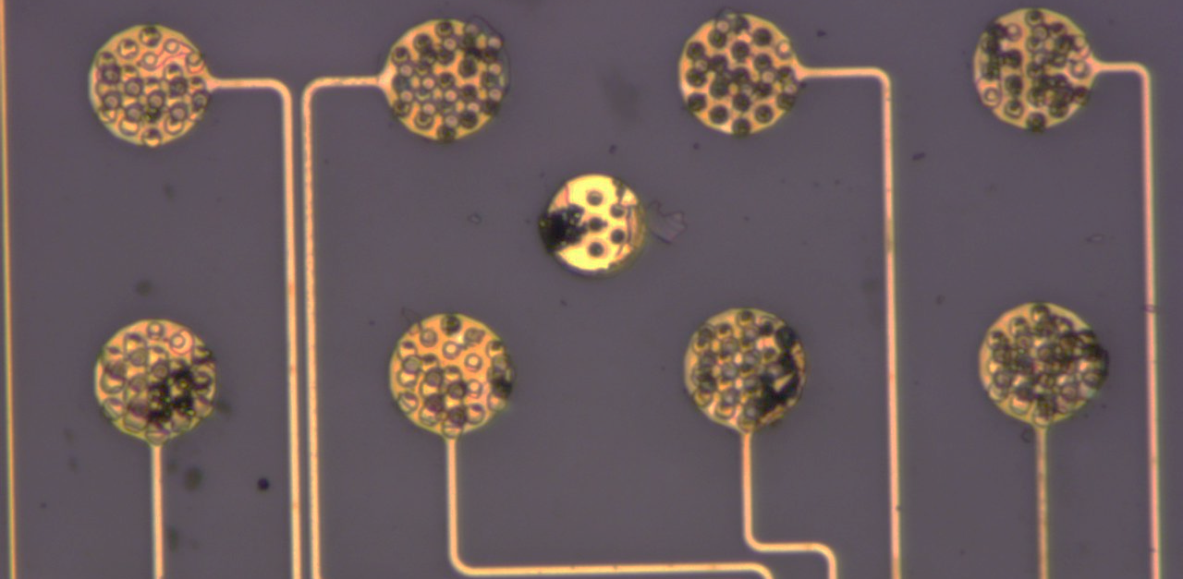
A70 (Back) Post Pull Test

Slide 14
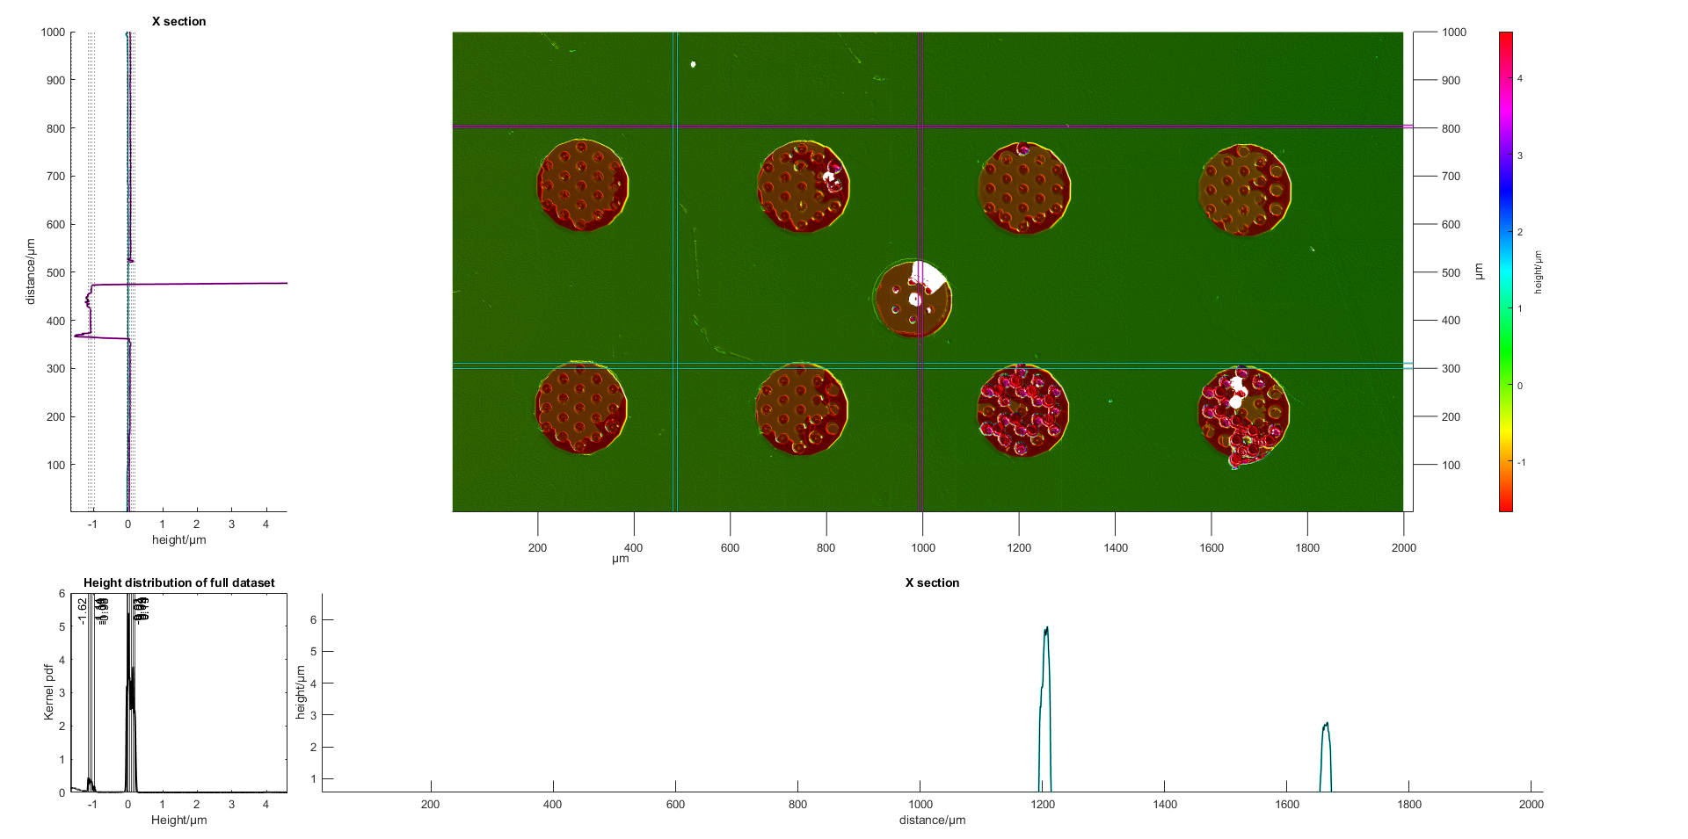
A70
Pad 1,2,5,6,7,8:
Vias broken off at 1.3um below surface
In regions where ‘mesh’ was seen on other strip, height is HIGHER than regions where mesh was absent (-1.3um vs -1.7um)
Is this the PECVD?
On the region with the vias, can see grey specks- presence of the titanium adhesion layer. No glass glinting seen.
Across multiple pads, the titanium is seen as crescent moon shapes

Slide 15
A70
Pad 3,4: Mostly individual vias present, with heights ranging from 4um to 10um. Indicating that failure at gold-gold interface as well as failure of gold-adhesion layer occurred at strip A60.
Pad 4: Top most via(from A60) was not in contact with other pad due to misalignment. This was transferred over to this strip, at a height of 9.3um.

Slide 16
A70
Pad 9:
Indentation of 1um was seen, with presence of vias rising to 4um.
South-east corner of pad was lifted up, indicating that failure occurred at the adhesion below this.

Slide 17
A70
Pad 2,3,4, 8:
Formation of ‘mesh’ seen again.
Approximate height of 8um.

Slide 18
A70
Pad 4:
Presence of very tall peaks detected – approx. 14um.
Perhaps failure beyond the PECVD layer, into the adhesion layer/ glass?
This is reflected in the corresponding Pad on A60.

Slide 19
A70
Pad 7:
From image before pull test, some glinting seen on backside. Seeing if this is reflected here in a delamination etc
On LHS of pad, see bonding of vias with ‘mesh’ at approx 4.5um high.
On RHS, have some missing data, but data present goes to
–4.6um, indicating that there is glass failure.

Slide 20
A70
Pad 9:
Indentation of 1um, with remnants of 3 vias and a small portion of the pad rising to 9um.
This has a similar height to what was seen on the corresponding pad on A60, indicating that bonding occurred on both sides, and the gold-gold interface was much stronger than the adhesion metal –gold interface.

Slide 21
A60 - A70
Overlay

Slide 22
Summary
Good bonding seen on all 18 pads
Glass failure seen on A60 Farside Pad 7, from bonding.
PECVD removed along with vias
Unexplained heights on pads where PECVD was removed
Pad 9 failed not at glass, but at adhesion metal to glass layer
Gold-gold bond is the strongest portion
Sharp ‘cliffs’ on all edges of pads indicates that no force is transmitted into the substrate
Main failure occurred between gold and adhesion layer.

